Slide 1






Electric cars vs Petrol Cars Analysis
Drive Clean, Go
Electric
analysing cost, performance, efficiency, and environmental impact of Electric cars (EVs) and Petrol cars to understand the factors that contribute to change The Future of Mobility.
YAT663B_CAI4_
DAT1_G5_DEPI4
Fast
Get the Beta Test Here
sustainable
Visit Here
Visit Here
GOOGLE DRIVE
GIT HUB
Efficient

Slide 2
Group-1
Data Analysis
TEAM MEMBERS
INST: SARA BESHIER
01
Team Leader
02
03
Nourhan Mostafa Rassem
Aliaa Ahmed Mohamed
Ahmed Farag Ahmed
04
05
06
Mohamed Abdallah Abdo
Mohamed Mounir Ibrahim
Manar Abdel raouf

Slide 3




Group-1
Data Analysis
TOOLS
SQL
for data extraction and transformation
andclean, filter, and structure the dataset
extract, clean, and aggregate the raw data, ensuring data accuracy and preparing it for analysis.
PYTHON
26422 CELLS
22 COLUMNS
1201 RAWS
perform analytical modeling and derive insights,applied to perform deeper analysis, calculate KPIs such as growth rates and affordability, and explore trends using data visualization.
Visit
POWER-BI
design interactive dashboards and present insights through visual storytelling, enabling stakeholders to make data-driven decisions.

Slide 4
data overview
DATA OVERVIEW
16
5
years
continental
time frame
starting from 2010 to 2025.
over euorpe , africa
apac,north america
south america, ociena
16
3
countries
segments
over 16 countries
all over the world
commercial, mass market
and premium segments

Slide 5
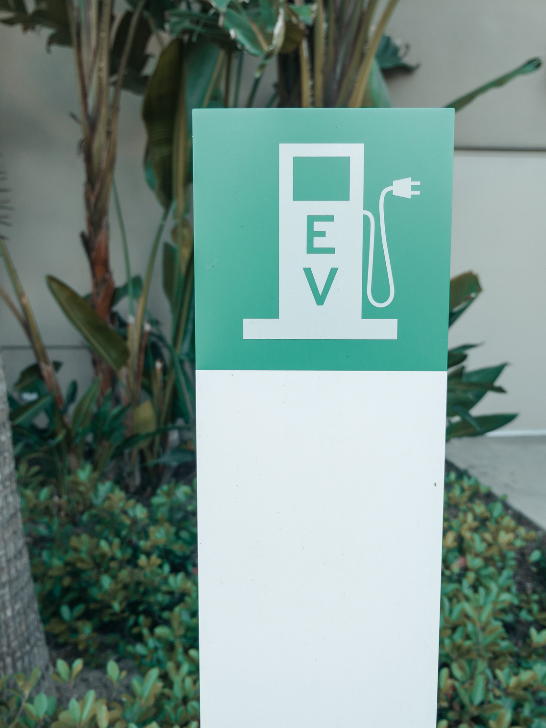
Group-1
Data Analysis
INSIGHTS
1-Is the market share of electric vehicles going up or down?
2-What are the top 10 countries in EV market share?
3- Which Vehicle segment has more electric Vehicles?
4-What drives EV success (infrastructure, pricing, policy)?
5-what is the enviromental impact of ev up market?
6-What future investments are required (charging, subsidies)?

Slide 6
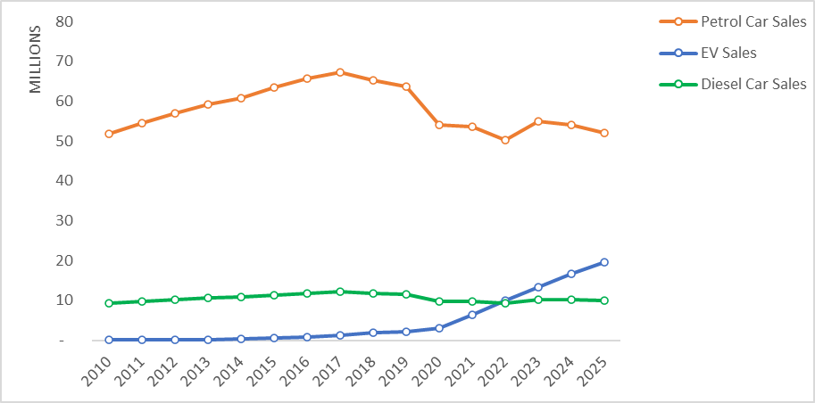


Compare market share
MARKET SHARE
& GROWTH
Electrical car sales
electrical cars market share has a great expansion over yaers.
Petrol car sales
Diesel car sales

Slide 7
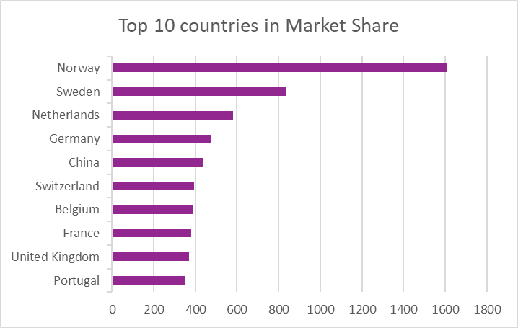
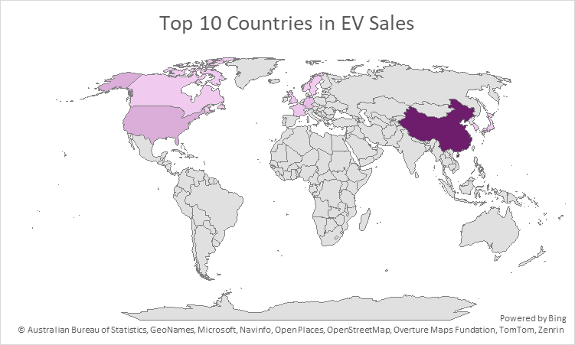
Compare market share
FASTEST GROWING MARKET

Slide 8
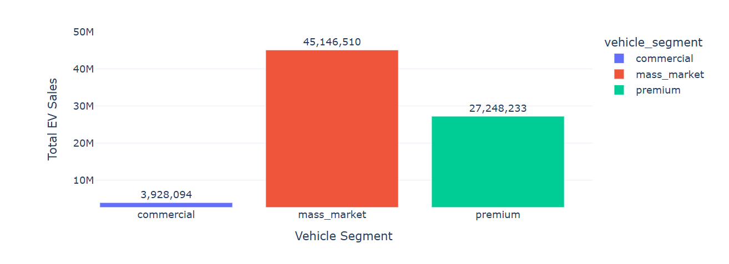
EV SALES BY VEHICLE SEGMENT
This chart analyzes EV sales across different vehicle segments such as mass market, premium, and commercial vehicles. It helps identify which segment contributes most to EV adoption and provides insights into customer demand and market distribution.

Slide 9
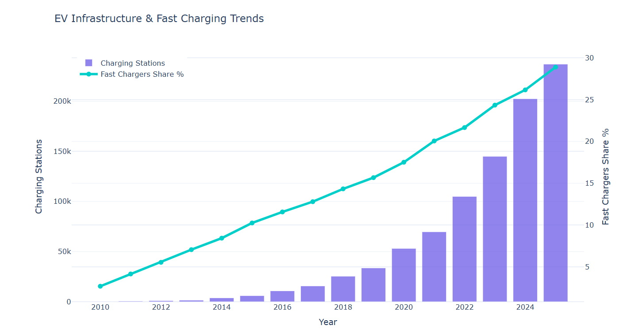
EV CHARGING INFRASTRUCTURE
This chart evaluates the development of EV infrastructure by comparing charging station growth with fast charger availability. It helps measure infrastructure readiness and supports understanding of how charging accessibility impacts EV adoption.

Slide 10
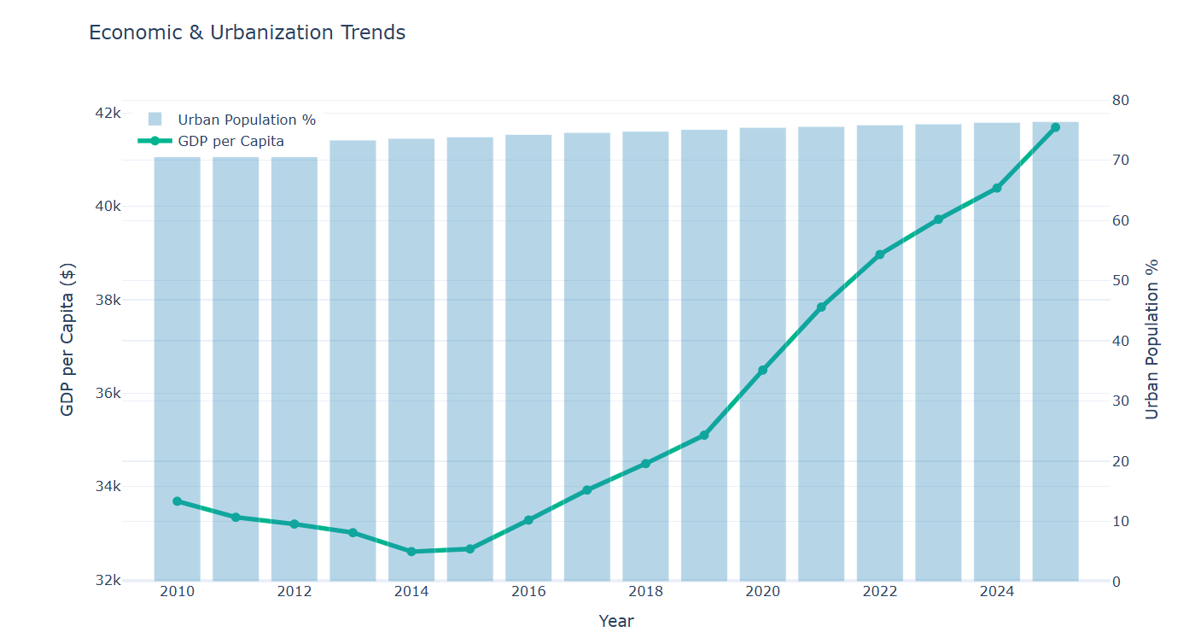
ECONOMIC & URBANIZATION TREND ANALYSIS
This chart compares GDP per capita and urban population trends over time to analyze how economic development and urbanization may influence EV market growth.

Slide 11
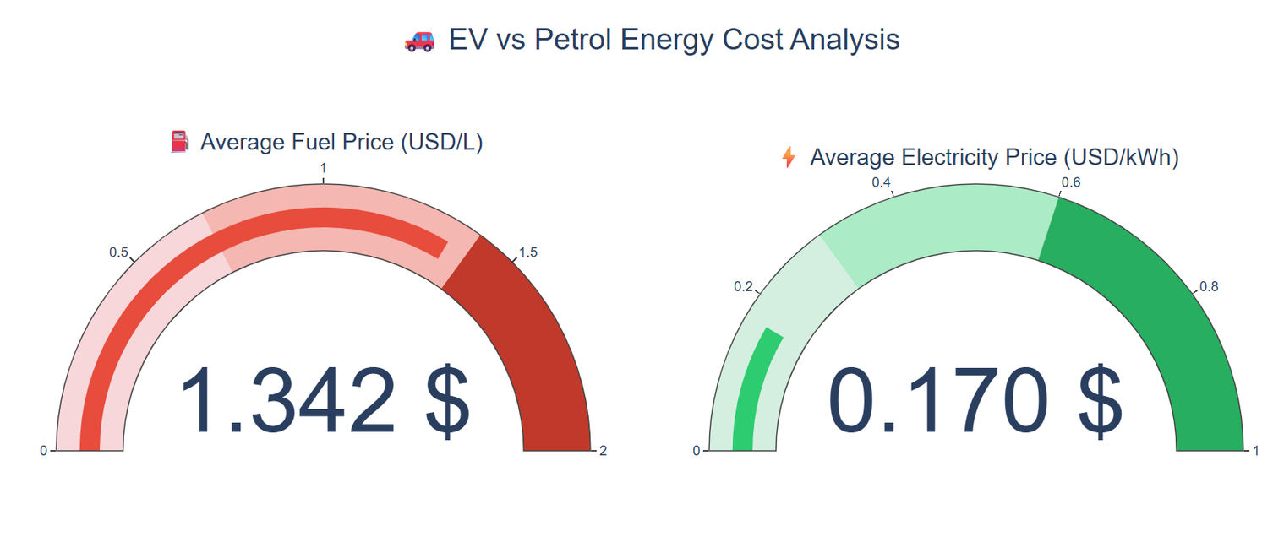
COST & AFFORDABILITY KPIS
This chart highlights the cost difference between fuel and electricity, demonstrating the economic advantage of electric vehicles. It helps evaluate EV affordability and shows how lower charging costs can support increased EV adoption.

Slide 12





affordability
COST & AFFORDABILITY KPIS
EV CARS
Electric vehicles offer lower running costs and better energy efficiency, achieving a global affordability score of 57%.
This dashboard compares the affordability and operational costs of petrol and electric vehicles using global market indicators.
Petrol Cars
Petrol vehicles show higher operating costs due to increasing fuel prices and maintenance expenses, reaching an affordability score of 89%.

Slide 13

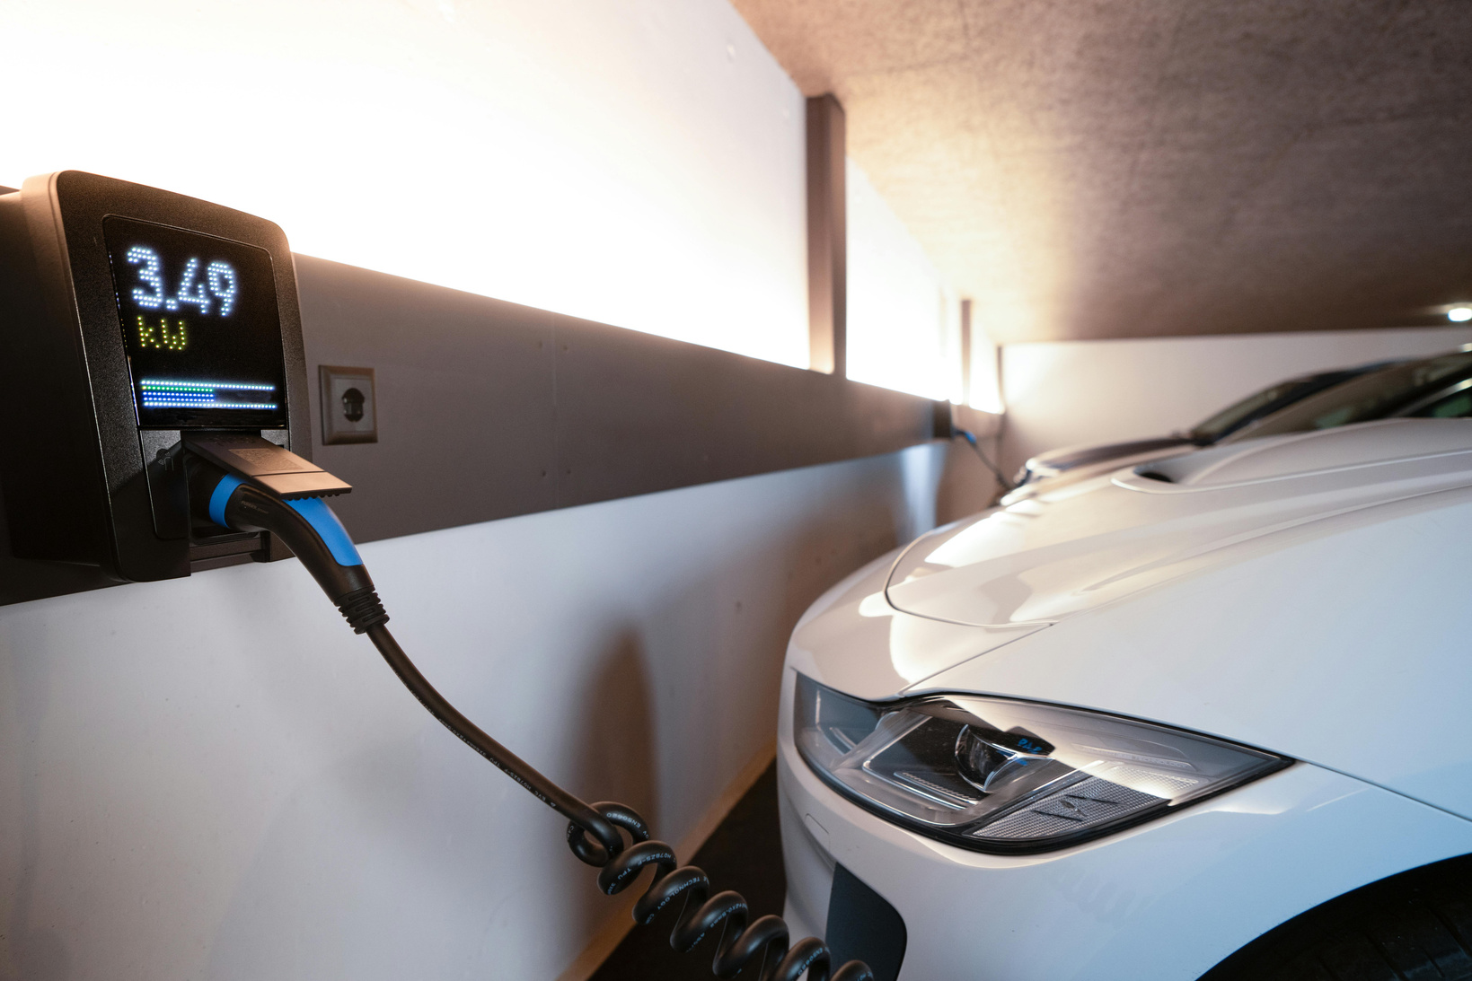
EV ecosystem
WHAT IS THE ENVIROMENTAL IMPACT OF EV UP MARKET?
Traditional gasoline and diesel cars release harmful gases such as carbon dioxide and nitrogen oxides, which contribute to global warming and health problems.
Electric vehicles produce no direct exhaust emissions, which helps improve air quality and create healthier urban environments

Slide 14
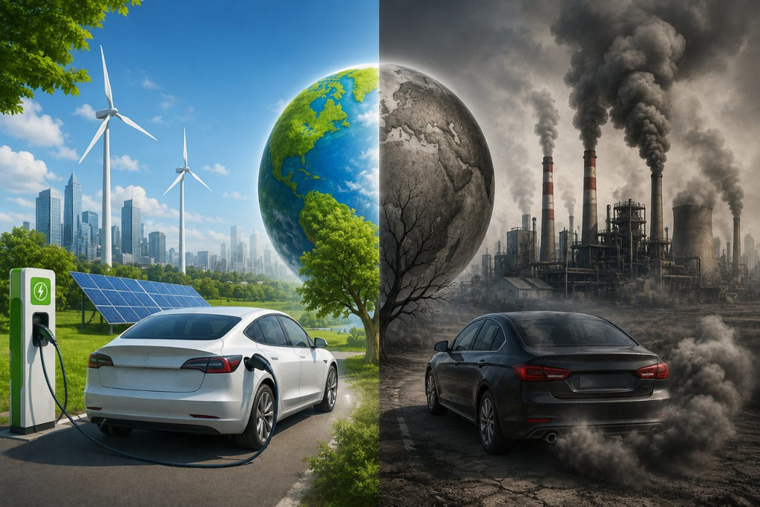
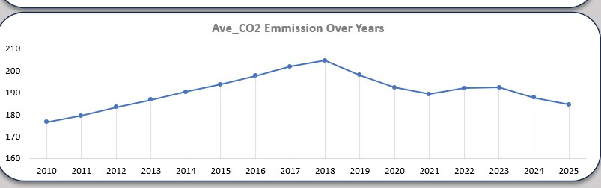
CO2 emissions
THE IMPACT OF ELECTRIC VEHICLES ON CO2 EMISSIONS.
if we look at the chart, it is evident that between 2018 and 2025, electric vehicle sales rose substantially
CO2 emissions during the same period decreased significantly.

Slide 15
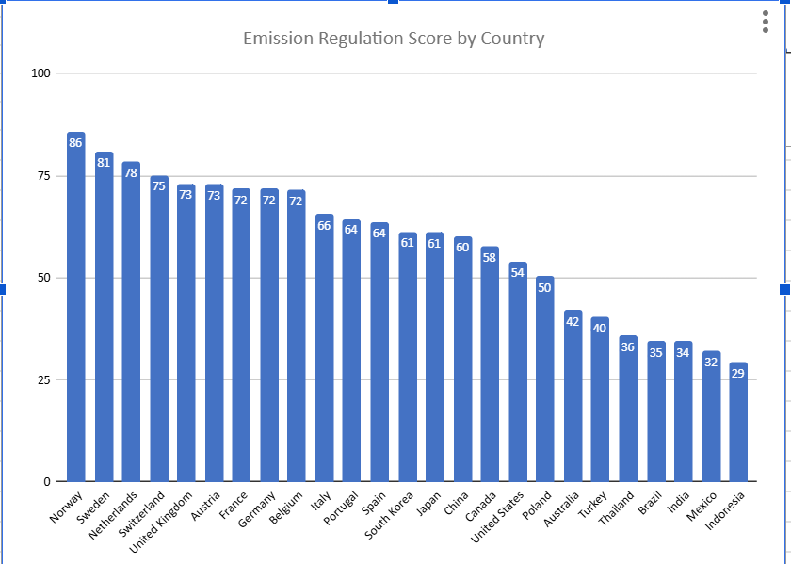
EV ecosystem
CAN THE REGULATION AFFECTS THE EV MARKET SHARE?

Slide 16
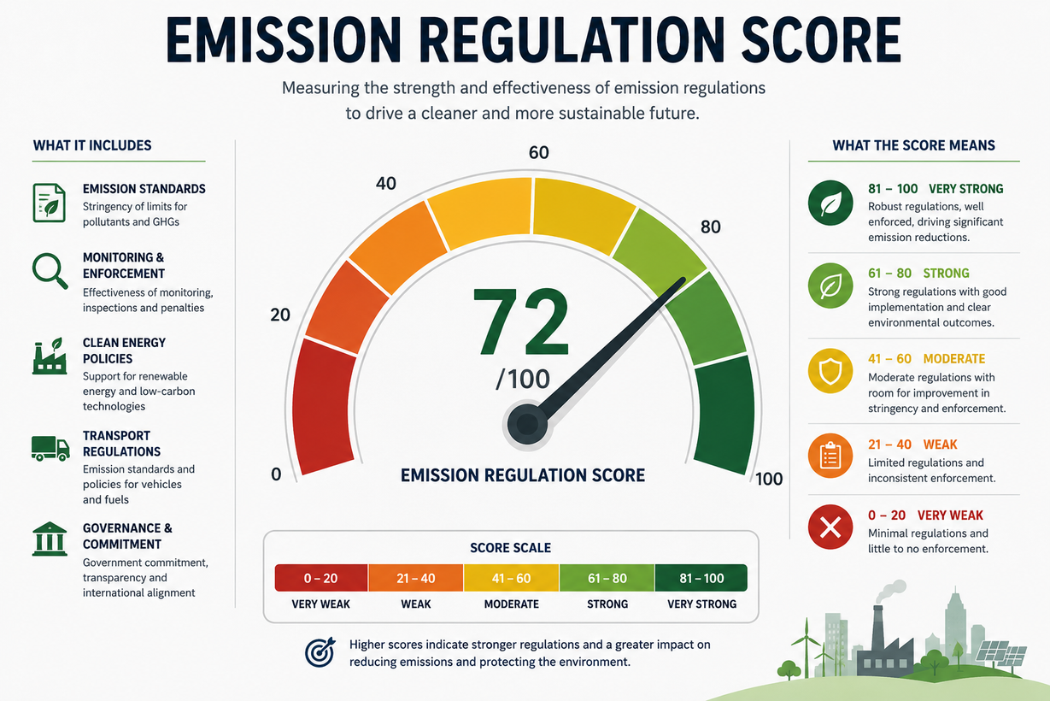
EV ecosystem
based on the chart showing, the country that has the highest emission score, has the highest EV market share.
Norway has the highest regulation score; furthermore, highest EV market share.

Slide 17
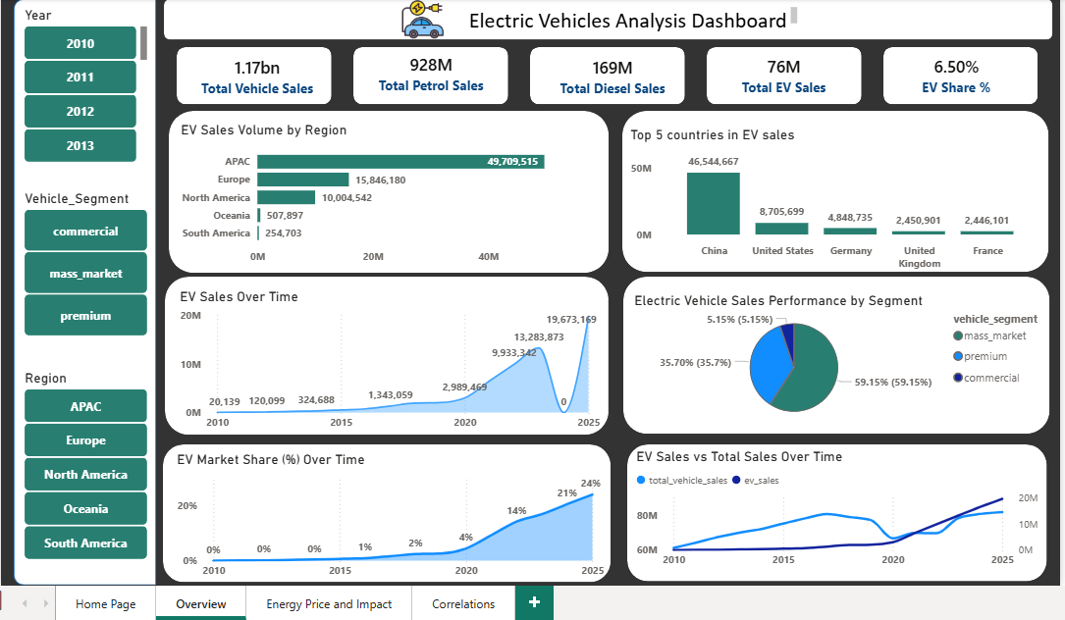

Slide 18
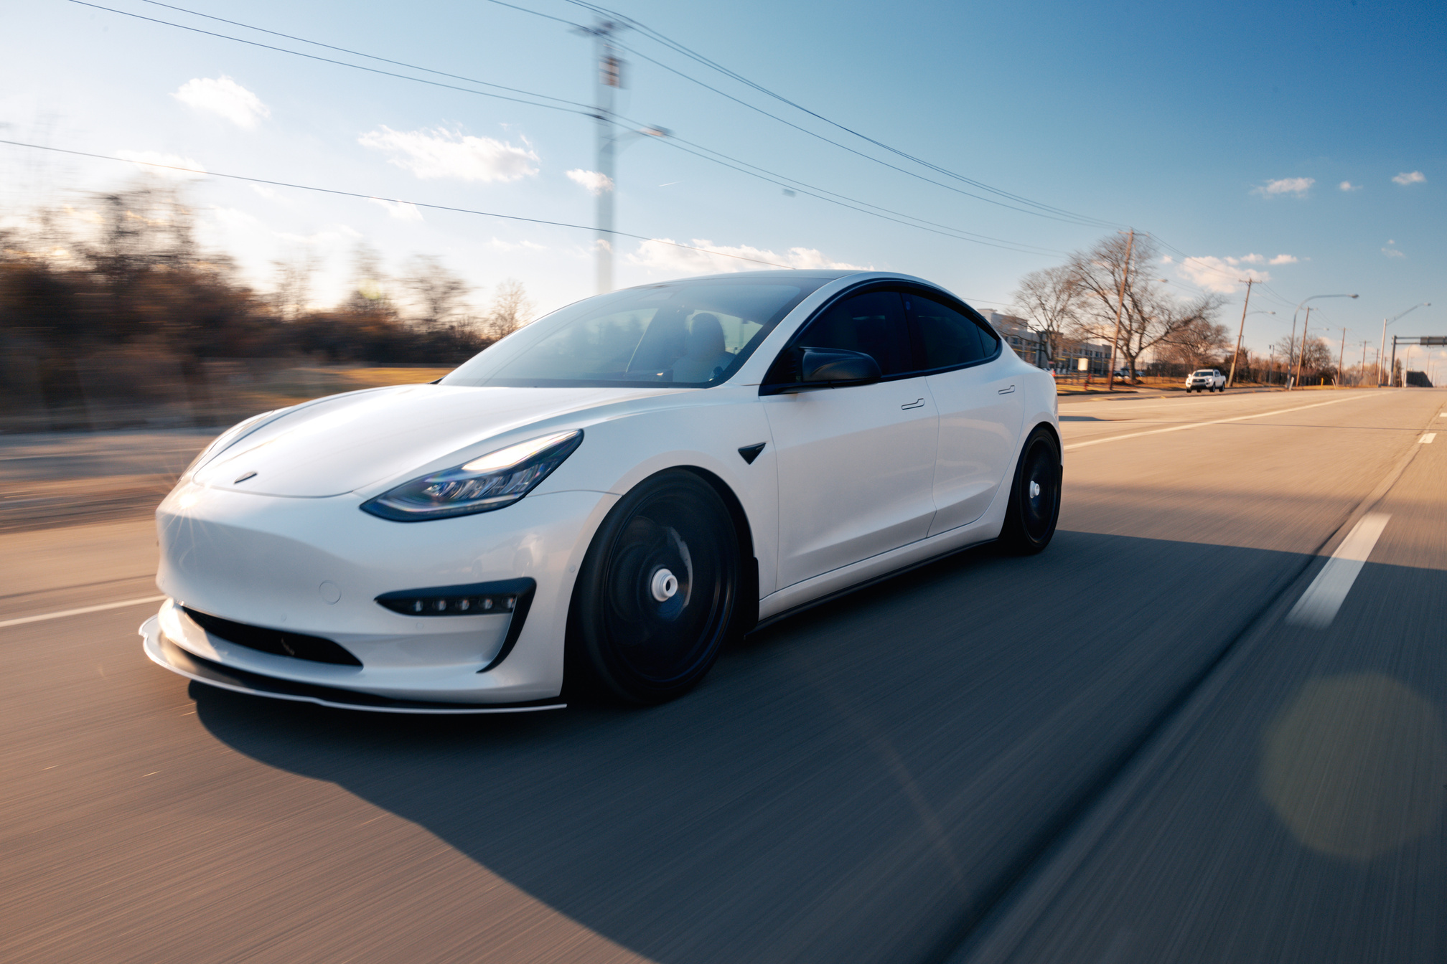
group-1
data analysis
Conclusion
The EV Sales accelerated Over Time
EV adoption significantly after 2020, reflecting increasing consumer demand.
APAC became the leading region in EV sales volume.
Norway achieved one of the highest EV market shares because of tax exemptions, fuel cost savings, and strong investment in EV infrastructure.

Slide 19
group-1
data analysis
Conclusion
“EV adoption aligns with sustainability targets”,where the rise in EV market share aligns with global efforts to reduce carbon emissions and support cleaner energy solutions
Government subsidies and regulations had a significant impact on EV market growth
Higher environmental awareness accelerated EV adoption globally.

Slide 20
group-1
data analysis
Globally, EV is growing fast but not yet dominant
This is openinig a great market for egypt to go through.
depends on:
Charging infrastructure
High fuel prices
Economic strength

Slide 21



group-1
data analysis
Thank You!
Get the Beta Test Here
Visit Here
Visit Here
GOOGLE DRIVE
GIT HUB
Data drives the future of sustainable mobility.

